Slide 1

Fruits
Coloring Book

Slide 2


Trace & Color
Fruits
Lemon

Slide 3


Trace & Color
Fruits
Coconut

Slide 4


Trace & Color
Fruits
Kiwi

Slide 5


Trace & Color
Fruits
Lime

Slide 6


Trace & Color
Fruits
Blueberry

Slide 7


Trace & Color
Fruits
Raspberry

Slide 8


Trace & Color
Fruits
Blackberry

Slide 9


Trace & Color
Fruits
Passion fruit

Slide 10


Trace & Color
Fruits
Tangerine

Slide 11


Trace & Color
Fruits
Apricot

Slide 12


Trace & Color
Fruits
Persimmon

Slide 13


Trace & Color
Fruits
Dragon fruit

Slide 14


Trace & Color
Fruits
Star fruit

Slide 15


Trace & Color
Fruits
Lychee

Slide 16


Trace & Color
Fruits
Grapefruit

Slide 17


Trace & Color
Fruits
Quince

Slide 18


Trace & Color
Fruits
Cherimoya

Slide 19


Trace & Color
Fruits
Kumquat

Slide 20


Trace & Color
Fruits
Melon

Slide 21

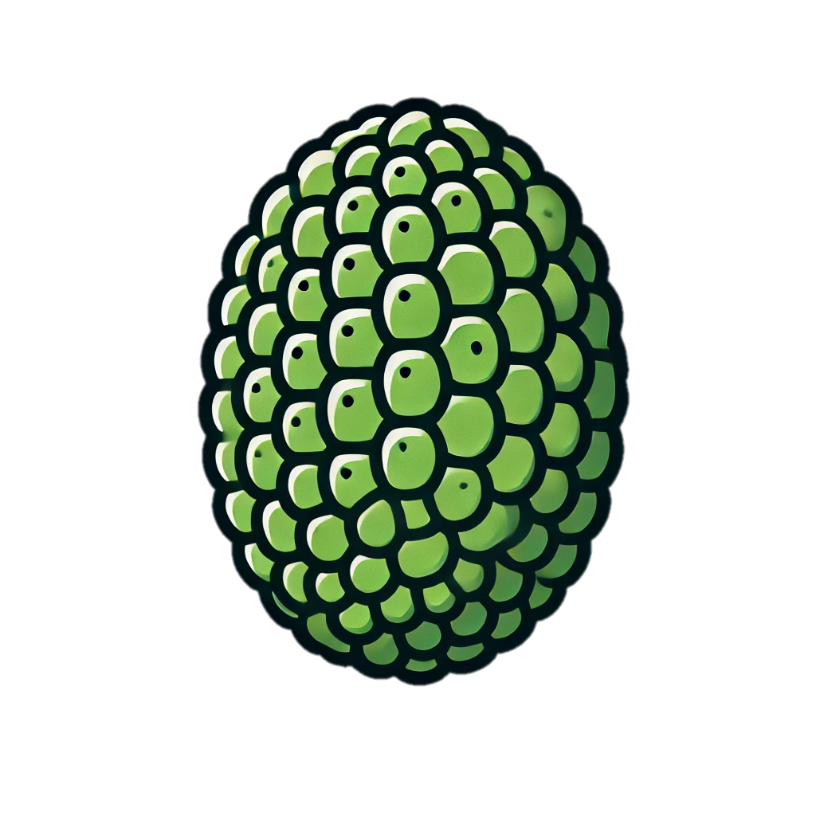
Trace & Color
Fruits
Jackfruit

Slide 22


Trace & Color
Fruits
Sapote

Slide 23
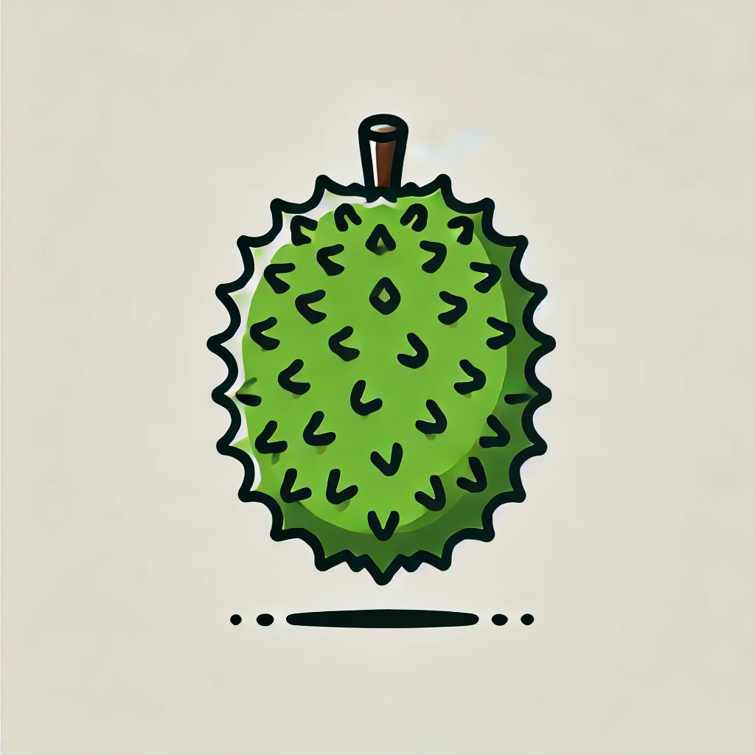


Trace & Color
Fruits
Soursop

Slide 24


Trace & Color
Fruits
Loquat

Slide 25


Trace & Color
Fruits
Nectarine

Slide 26


Trace & Color
Fruits
Rambutan

Slide 27


Trace & Color
Fruits
Cashew

Slide 28

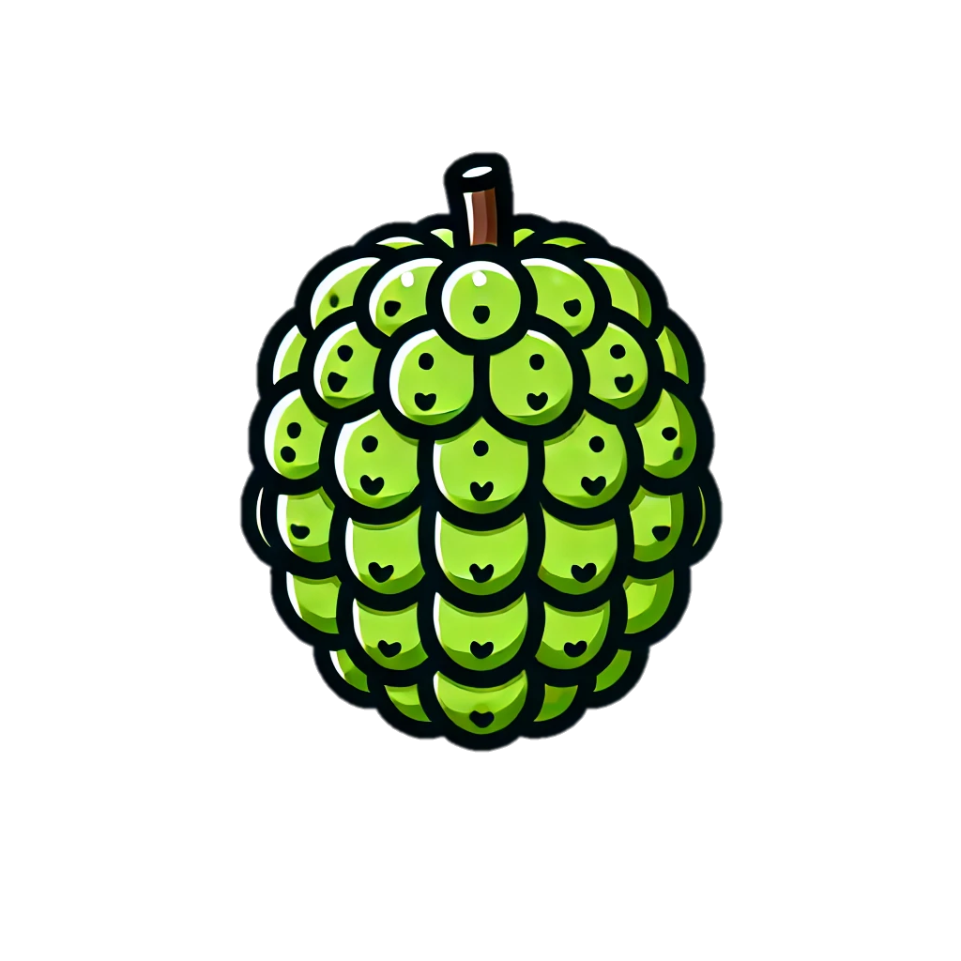
Trace & Color
Fruits
Custard apple

